Slide 1

Python
- Nidhi Vaishnav

Slide 2

Learning

Slide 3
Print
print(“Hello world”)
x=5 #Here x is variable with value 5
print (x) # For string, put quotes. For variable, No quotes
print (“ value of x={}“.format(x))
#string and variable with proper format - preferable

Slide 4
Input
Var=input() #to take input
Var=input(“Please provide input:”)
# use above method, take input with description,
#so that user can understand what input is

Slide 5
Type
type(variable_name) #To check the type of the variable

Slide 6
Mathematical Operators:
+ #addition
- #subtraction
* #multiplication
/ #division
% #modulo
** #power

Slide 7
String Operators:
+ #string concatenation
Str1 = “hello”, Str2 = “world”
Con = str1+str2 #Con -> helloworld
* #string multiplication
Mul = str1*3 #Mul -> hellohellohello
Str.lower() #converts String in lower case
Str.upper() # converts String in upper case

Slide 8
Comparison
Always returns True or False
== #equals to
< #less than
<= #less than or equals to
> #greater than
>= # greater than or equals to
Str.islower() #checks whether the entire string is in lower case or not
Str.isupper() #checks whether the entire string is in upper case or not

Slide 9
If – else condition
if (condition):
#do something 1
elif(condition): #optional
#do something 2
else: #optional with if, compulsory with if-elif
#do something 3

Slide 10
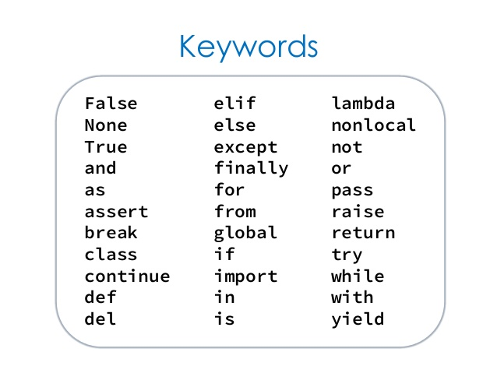

Slide 11
Tasks

Slide 12

Find the area of circle
Take radius as input from the user, and calculate area of circle
Hint: Area of circle : $πr^{2}$

Slide 13
Find the area of Rectangle
Take length l and width w as inputs from the user
calculate area of the rectangle

Slide 14
Even - odds
Check whether the input number is even or odd.

Slide 15
Determine Age
Take age from user
Check age
If Age<13 than User is a kid
If Age>=13 and Age<=19 than User is a teen
If Age>19 than user is an Adult

Slide 16
String case operation
Check whether user input is in lower case or upper case, print the answer.
#Return the 2 new string, one with upper case and second in lower case. (incomplete)

